Slide 1


Incremental Learning with Support Vector Machines on Embedded Platforms
Master Thesis - Initial Talk
Shankar Kumar
Computer Engineering Group, Paderborn University
shanks@mail.upb.de
Notes:
What are Support Vector Machines?
Why Support Vector Machines?
Why Support Vector Machines/ Machine Learning on Embedded Systems?
Why Incremental Learning?
How to get all of this done?

Slide 2
Outline
Introduction
Support Vector Machines
Solving the SVM Problem
The Kernel trick
Embedded Systems and Machine Learning
Incremental Learning and Approximations
System Architecture
Objectives and Timeline

Slide 3
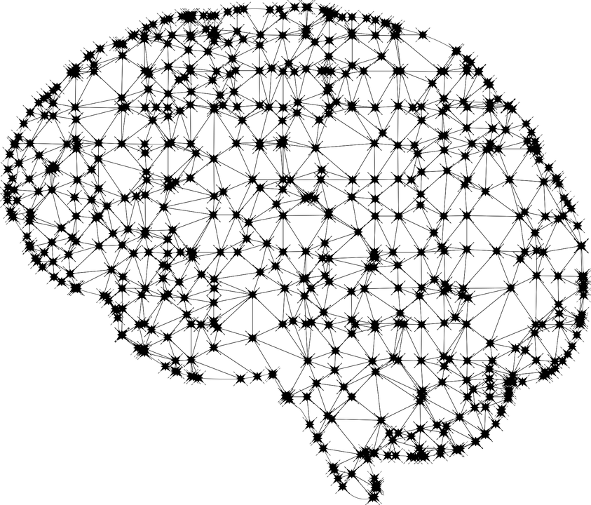
Machine Learning
Source: Google Images
Notes:
Autonomous driving
Image recognition
Natural Language Processing

Slide 4
Machine Learning Hierarchy
Machine Learning
Supervised Learning
Unsupervised Learning
Reinforcement Learning
Regression Problem
Classification Problem
Clustering Problem
Dimension Reduction
Linear Regression
Logistic Regression
Support Vector Machines
K means
Principal Component Analysis

Slide 5
Algorithms for Classification
Logistic Regression
Naïve Bayes
Stochastic Gradient Descent
K-Nearest Neighbours
Decision Tree
Random Forest
Support Vector Machines

Slide 6
Why Support Vector Machines?
Mathematical formulation is easily understandable
Fast, simple algorithm and scalable
Most of the training data is redundant after training
Notes:
Support Vectro Machines versus Neral Networks
Support Vector Machies don’t store all the data but only the supporting Vectors for its decision boundary

Slide 7
Outline
Introduction
Support Vector Machines
Solving the SVM Problem
The Kernel trick
Embedded Systems and Machine Learning
Incremental Learning and Approximations
System Architecture
Objectives
Timeline

Slide 8
Decision Boundary
This is what SVM does!
y
y
y
y
x
x
x
x
Notes:
When a training set is linearly separable there usually is an infinity of separating hyperplanes. The advantage of SVM is that once a boundary is established, most of the training data is redundant. All it needs is a core set of points which can help identify and set the boundary. These data points are called support vectors because they "support" the boundary.

Slide 9
Outline
Introduction
Support Vector Machines
Solving the SVM Problem
The Kernel trick
Embedded Systems and Machine Learning
Incremental Learning and Approximations
System Architecture
Objectives and Timeline

Slide 10
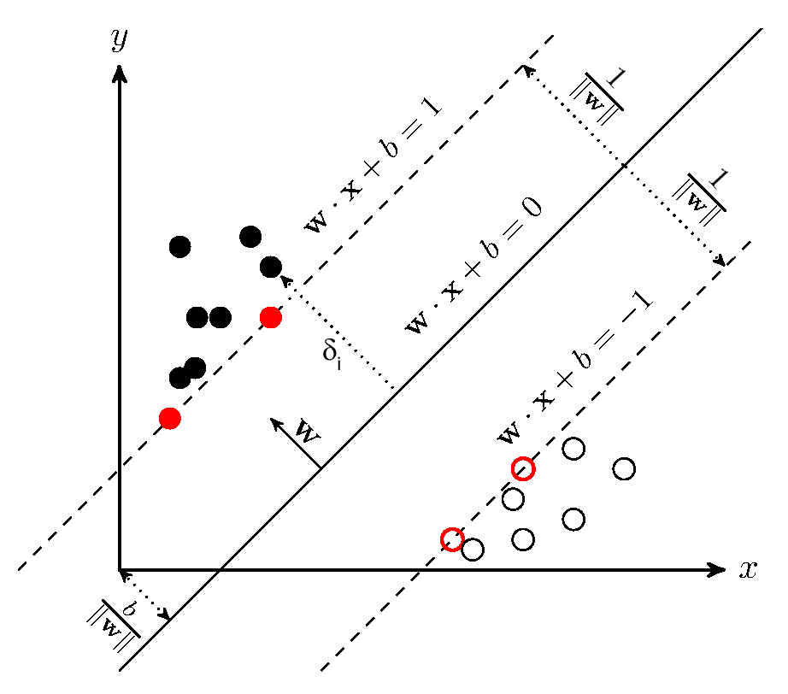




SVM Mathematical Formulation
margin
margin
w
= normal vector to the plane
= geometric distance from the origin
= minimize this to maximize the distance
= positive sample
= negative sample
Notes:
The w and b that solve this problem determine our classifier, sign of the corresponding solution denoted class/label

Slide 11

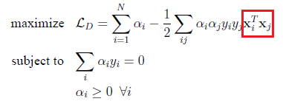
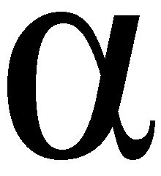
SVM Mathematical Formulation
The problem state of SVM is a constrained optimization problem as follows:
Lagrange primal problem statement (above) but solved by the dual version of problem statement (below):
= Lagrangian Multipler
C = Penalty Hyperparameter
KKT Conditions:
This now reduces to a Quadratic Optimization problem
0 <
< C
Sample is a support Vector
= 0
Correctly labeled sample
= C
Incorrectly labeled sample
Notes:
Directly solving this problem is difficult because the constraints are quite complex. The mathematical tool of choice for simplifying this problem is the Lagrangian duality
Thus solving the SVM problem is equivalent to finding a solution to the KKT conditions

Slide 12
Solving the SVM Problem
Quadratic Optimization Problem
Can be solved by SGD, simplex, coordinate descent, gradient projection, cutting plane, interior point- relatively complex, poor scaling and large setup times.
SMO - Sequential Minimal Optimization
Invented by John Platt in 1998 at Microsoft Research
LibSVM, based on SMO - backbone of Sci Kit Learn
Notes:
The best learning times were often achieved using working sets containing very few examples as in SMO - 2

Slide 13
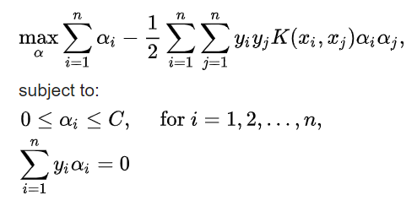

The SMO Algorithm
The dual version of SVM problem statement:
Find a Lagrange multiplier α₁ that violates the Karush-Kuhn-Tucker Conditions for the optimization problem
Pick a second multiplier α₂ and optimize the pair (α_{1,}α₂)
Repeat steps 1 and 2 until convergence.
For any two multipliers α₁ α_{2,} the constraints are reduced to:
Reduces the problem to minimize a one-dimensional quadratic function.

Slide 14




Non Linearly Separable Data
meow
meow
meow
Source: Google Images

Slide 15
Outline
Introduction
Support Vector Machines
Solving the SVM Problem
The Kernel trick
Embedded Systems and Machine Learning
Incremental Learning and Approximations
System Architecture
Objectives and Timeline

Slide 16
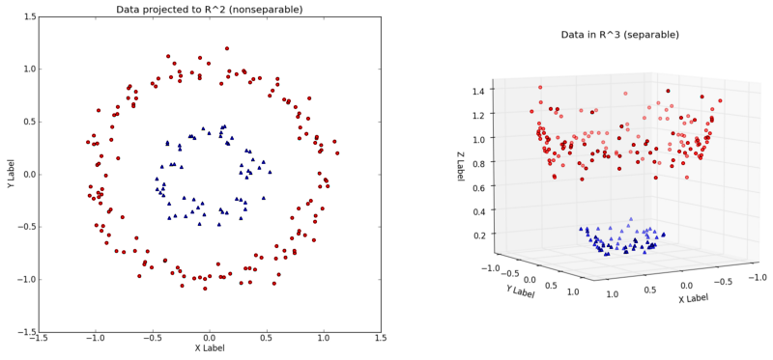
The Kernel Trick
Source: Wikipedia
Notes:
In its simplest form, the kernel trick means transforming data into another dimension that has a clear dividing margin between classes of data. The resulting algorithm is formally similar, except that every dot product is replaced by a nonlinear kernel function.

Slide 17

The Kernel Trick
Function
Original sample space
New feature space
Notes:
Computationally Complex to find the Phi Function, hoping that they can be separable in the feature space

Slide 18
The Kernel Trick
“If an algorithm is described solely in terms of inner products in input space then it can be lifted into feature space by replacing occurrences of those inner products by k(x,x’); this is sometimes called the kernel trick.”
- Rasmussen and Williams, “Gaussian Processes for Machine Learning,” MIT press, 2006.
Φ(X_{i}) ^{T}. Φ(X_{j}) = K(X_{i}^{T},X_{j})

Slide 19
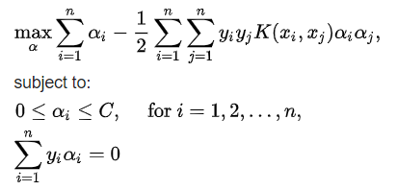
The Kernel Trick in SVM
Dual version of problem statement:
Notes:
Increasing the dimensionality of the data

Slide 20
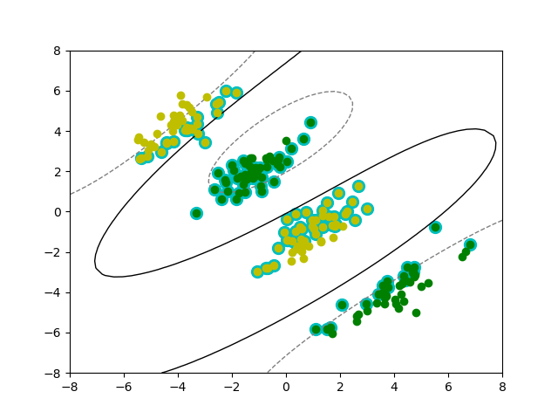
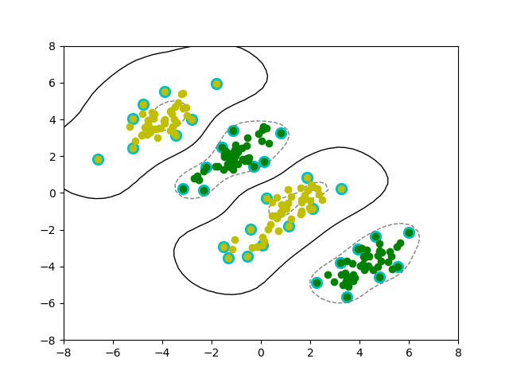
SVM with Kernel Functions
Polynomial Kernel
Radial Basis Function Kernel

Slide 21
Outline
Introduction
Support Vector Machines
Solving the SVM Problem
The Kernel trick
Embedded Systems and Machine Learning
Incremental Learning and Approximations
System Architecture
Objectives and Timeline

Slide 22


Embedded Systems and Machine Learning
Anomaly Detection
Quality Assurance
Notes:
As always with Embedded Systems what is the main bottle neck ? Memory

Slide 23
Memory Bottleneck
[ Top 10 ]
C:\Users\Shankar\PycharmProjects\TestProject\venv\lib\site-packages\sklearn\utils\__init__.py:216: size=356 MiB, count=4, average=89.1 MiB
C:\Users\Shankar\AppData\Local\Programs\Python\Python37\lib\site-packages\numpy\core\shape_base.py:234: size=37.4 MiB, count=19, average=2013 KiB
C:/Users/Shankar/PycharmProjects/TestProject/MultiClassSVM-SMO.py:159: size=37.4 MiB, count=21, average=1821 KiB
C:/Users/Shankar/PycharmProjects/TestProject/MultiClassSVM-SMO.py:157: size=153 KiB, count=20, average=7846 B
C:/Users/Shankar/PycharmProjects/TestProject/MultiClassSVM-SMO.py:158: size=51.0 KiB, count=22, average=2373 B
C:/Users/Shankar/PycharmProjects/TestProject/MultiClassSVM-SMO.py:208: size=48.9 KiB, count=2, average=24.4 KiB
C:\Users\Shankar\AppData\Local\Programs\Python\Python37\lib\linecache.py:137: size=11.4 KiB, count=119, average=98 B
C:/Users/Shankar/PycharmProjects/TestProject/MultiClassSVM-SMO.py:88: size=4032 B, count=28, average=144 B
C:/Users/Shankar/PycharmProjects/TestProject/MultiClassSVM-SMO.py:64: size=2872 B, count=7, average=410 B
C:/Users/Shankar/PycharmProjects/TestProject/MultiClassSVM-SMO.py:66: size=1680 B, count=10, average=168 B
Notes:
There are two different aspects to this — (1) memory-intensive while training, and (2) memory-intensive while prediction.
SVMs are memory-intensive while training, if you are working in the dual space. This is because you need to store an NxN kernel matrix, which may be very large if N is large. If you do not store the kernel matrix, then you have to recompute the kernel values repeatedly, making the training much slower. At prediction time, SVM takes a linear combination of all support vectors. So, if there are a lot of support vectors, you need to store all of them. This might be problematic if you want to deploy your model on low-memory devices such as cell phones.
ideally, we hope to train all the learning data simultaneously in order to obtain the best estimate of data distribution. But when the size of training samples is large, all the training samples cannot be loaded into the memory of our computer at one go. One of the strategies to overcome this question is to train the classifier using an incremental learning technique,

Slide 24
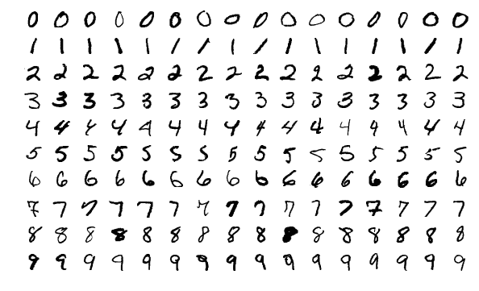
Incremental Learning
Divide Input data into mini batches
Only Support Vectors are retained
Corresponding KKT conditions preserved

Slide 25
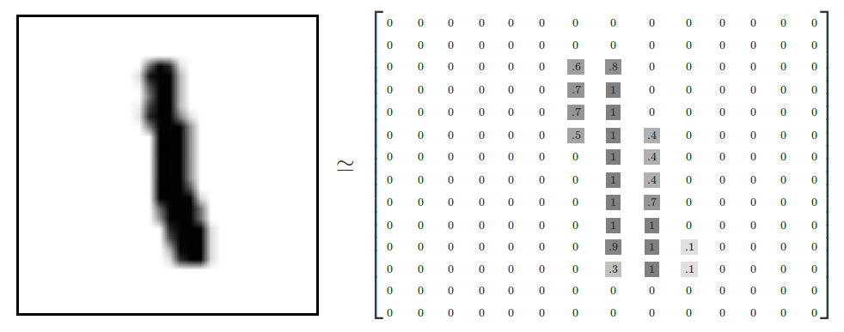
Approximations
Sparsity Techniques
Fewer number of parameters
Reducing Precision datatypes and operations
Notes:
sparsity provides the opportunity to considerably reduce the memory and time requirements of SVM solvers.

Slide 26
Outline
Introduction
Support Vector Machines
Solving the SVM Problem
The Kernel trick
Embedded Systems and Machine Learning
Incremental Learning and Approximations
System Architecture
Objectives and Timeline

Slide 27
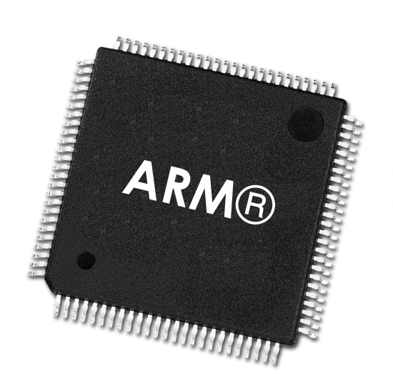


System Architecture – State of the art
Previous Work:
Complete SVM on FPGA in HDL
Non-Kernalized models like Stochastic Gradient Descent and Logistic Regression
Mostly binary classification
Ref: Shereen Moataz Afifi et. al; SVM on FPGA: A State-of-the-Art Review of Current Practice

Slide 28
System Architecture
Computations in Hardware:
Kernel computation
Vector Multiplications
Optimizations for streaming samples
Selection of multiple pairs of Alphas
Adder
Matrix Multiplier
Streaming Interface over DMA
FPGA
ARM Core
Kernel Computer

Slide 29
Outline
Introduction
Support Vector Machines
Solving the SVM Problem
The Kernel trick
Embedded Systems and Machine Learning
Incremental Learning and Approximations
System Architecture
Objectives and Timeline

Slide 30

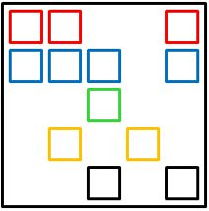
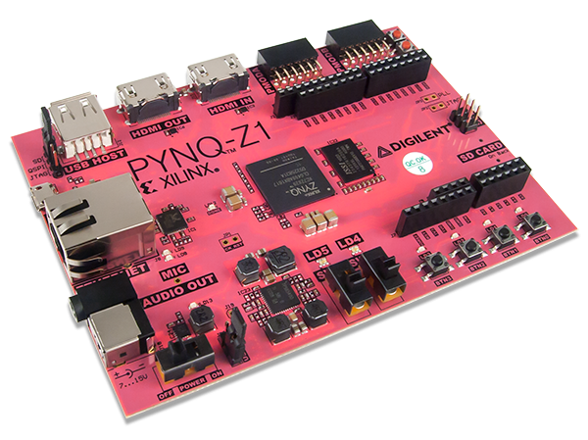
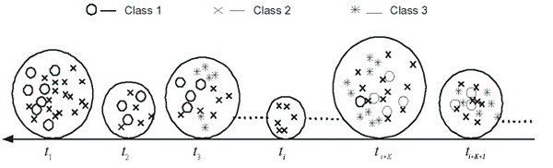
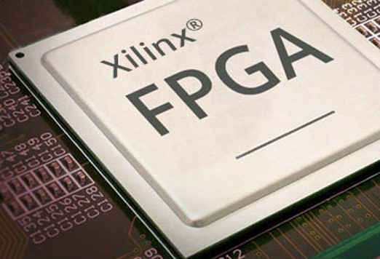
Objectives
SVM Implementation
Incremental / Online learning
Approximation Methods
Implementation on an Embedded Platform
Offload tasks to FPGA for acceleration
SMO

Slide 31
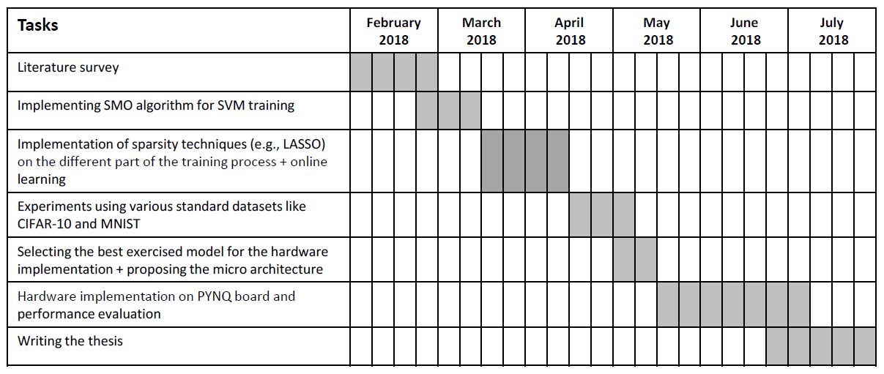
Timeline

Slide 32

Questions?

